Slide 1
Introduction to Networks
By
Harish Kumar H C
Asst.Professor

Slide 2
Data communication
When we communicate, we are sharing information. This sharing can be local or remote.
The word data refers to information presented in whatever form is agreed upon by the parties creating and using the data.
Data communications are the exchange of data between two devices via some form of transmission medium.
For data communications to occur, the communicating devices must be part of a communication system made up of a combination of
hardware (physical equipment)
software (programs)

Slide 3
Data communication
The effectiveness of a data communications system depends on 4 fundamental characteristics:
Delivery
The system must deliver data to the correct destination.
Accuracy
The system must deliver the data accurately.
Data that have been altered in transmission and left uncorrected are unusable.
Timeliness
The system must deliver data in a timely manner.
Data delivered late are useless.
In the case of video and audio, timely delivery means delivering data as they are produced, in the same order that they are produced, and without significant delay (real-time data).
4. Jitter
Jitter refers to the variation in the packet arrival time.

Slide 4
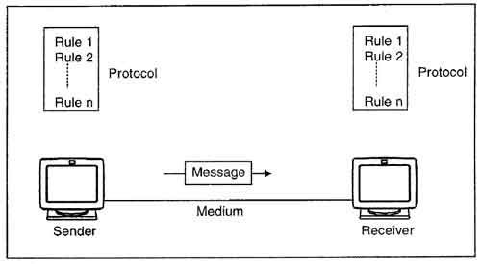
Components
A data communications system has five components.
Message
Receiver
Sender
Transmission medium
protocol

Slide 5
components
Message
The message is the information (data) to be communicated.
Popular forms of information include
text,numbers,pictures,audio, video.
Sender
The sender is the device that sends the data message.
It can be a computer, workstation, telephone handset, video camera, and so on.
Receiver
The receiver is the device that receives the message.
It can be a computer, workstation, telephone handset, television, and so on.
Transmission medium
The transmission medium is the physical path by which a message travels from sender to receiver.
transmission media include twisted-pair wire, coaxial cable, fiber-optic cable, and radio waves.
Protocol
A protocol is a set of rules that govern data communications.
It represents an agreement between the communicating devices.
Without a protocol, two devices may be connected but not communicating.

Slide 6
Data Representation
Information today comes in different forms such as
Text.
Numbers.
Images.
Audio.
video.

Slide 7
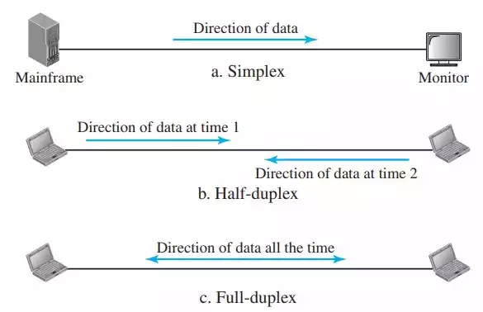
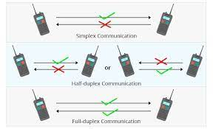
Data Flow
Communication between two devices can be
Simplex.
Half-duplex.
Full-duplex

Slide 8
Data Flow
1. Simplex
The communication is unidirectional. (as on a one-way street).
Only one of the two devices on a link can transmit; the other can only receive.
Keyboards and traditional monitors are examples of simplex devices.
The simplex mode can use the entire capacity of the channel to send data in one direction.
2. Half Duplex
Each station can both transmit and receive, but not at the same time.
When one device is sending, the other can only receive, and vice versa.
The half-duplex mode is like a one-lane road with traffic allowed in both directions.
In a half-duplex transmission, the entire capacity of a channel is taken over by whichever of the two devices is transmitting at the time.

Slide 9
Data Flow
3. full-duplex
Both stations can transmit and receive simultaneously.
The full-duplex mode is like a two-way street with traffic flowing in both directions at the same time.
In full-duplex mode, signals going in one direction share the capacity of the link with signals going in the other direction.
Entire capacity of the channel is divided between signals traveling in both directions.

Slide 10
Networks
A network is the interconnection of a set of devices capable of communication.
A device can be a host (end system) such as a large computer, desktop,laptop,workstation, cellular phone or security system.
A device can be a connecting device such as
Router - which connects the network to other networks,
Switch - connects device together
E.g. Modem( Modulation and de-modulation) which changes the form of data and so on
Devices in a network are connected using wire or wireless link

Slide 11
Network Criteria
A network must be able to meet a certain number of criteria. The most important of these are
Performance.
Reliability.
Security.
Performance: can be measured in many ways, including
Transit time : the amount of time required for a message to travel from one device to another device.
Response time: the elapsed time between an inquiry and a response.
The performance of a network depends on a number of factors, including
The number of users.
The type of transmission medium.
The capabilities of the connected hardware.
The efficiency of the software.

Slide 12
Network Criteria
Performance is often evaluated by two networking metrics:
Throughput
It is the determination of the amount of data is transmitted during a specified time period via a network, interface or channel. Also called as effective data rate or payload rate.
Delay
The amount of time required for one packet to go from its source to a destination.
We often need more throughput and less delay

Slide 13
Network Criteria
Reliability
Network reliability is measured by the frequency of failure, the time it takes a link to recover from a failure.
Security
protecting data from unauthorized access,
Protecting data from damage and development,
implementing policies and procedures for recovery from breaches and data losses.

Slide 14
Physical Structures
Type of Connection
A network is two or more devices connected through links.
A link is a communications pathway that transfers data from one device to another.
There are two possible types of connections:
point-to-point
multipoint.
Point-to-Point
A point-to-point connection provides a dedicated link between two devices.
The entire capacity of the link is reserved for transmission between those two devices.
Most point-to-point connections use an actual length of wire or cable to connect the two ends, but other options, such as microwave or satellite links, are also possible

Slide 15
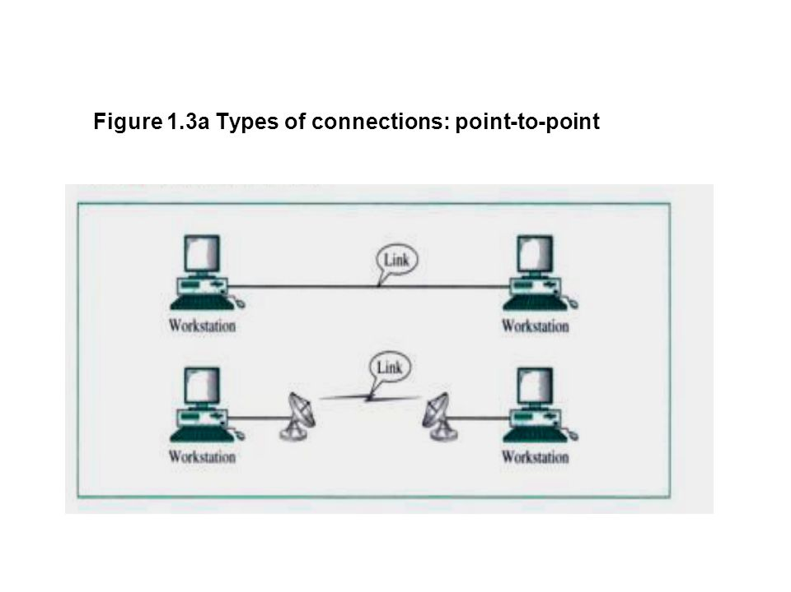
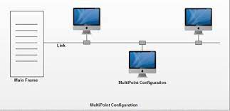
Types of connections: point-to-point and multipoint

Slide 16
Physical Structures
Multipoint
A multipoint (also called multidrop) connection is one in which more than two specific devices share a single link.
In a multipoint environment, the capacity of the channel is shared, either spatially or temporally.
Spatially shared : If several devices can use the link simultaneously.
Temporally shared: users must take turns, it is a timeshared.

Slide 17
Physical Topology
The term physical topology refers to the way in which a network is laid out physically.
One or more devices connect to a link.
Two or more links form a topology.
The topology of a network is the geometric representation of the relationship of all the links and linking devices (usually called nodes) to one another.
There are four basic topologies possible:
Mesh
Star
Bus
Ring

Slide 18
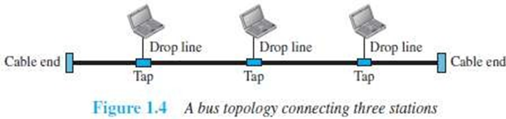
Bus Topology
All the devices are connected to the single cable called bus.
Every device communicates with the other device through this bus.
A data from the source is broadcasted to all devices connected to the bus.
Only the intended-receiver, whose physical-address matches, accepts the data.
Devices are connected to the bus by drop-lines and taps.
A drop-line is a connection running between the device and the bus.
A tap is a connector that links to the bus

Slide 19
Bus Topology
Advantages:
Easy installation.
Cable required is the least compared to mesh/star topologies.
Redundancy is eliminated.
Costs less (Compared to mesh/star topologies).
Mostly used in small networks. Good for LAN.
Disadvantages:
Difficult to detect and troubleshoot fault.
Signal reflection at the taps can cause degradation in quality.
A fault/break in the cable stops all transmission.
There is a limit on
Cable length
Number of nodes that can be connected.
Security is very low because all the devices receive the data sent from the source.

Slide 20
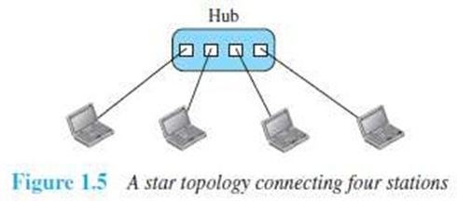
Star Topology
All the devices are connected to a central controller called a hub.
There exists a dedicated point-to-point link between a device & a hub.
The devices are not directly linked to one another. Thus, there is no direct traffic between devices.
The hub acts as a junction:
If device-1 wants to send data to device-2, the device-1 sends the data to the hub, then the hub relays the data to the device-2.

Slide 21
Star Topology
Advantages:
Less expensive: Each device needs only one link & one I/O port to connect it to any devices.
Easy installation & reconfiguration: Nodes can be added/removed w/o affecting the network.
Robustness: If one link fails, it does not affect the entire system.
Easy to detect and troubleshoot fault.
Centralized management: The hub manages and controls the whole network.
Disadvantages:
Single point of failure: If the hub goes down, the whole network is dead.
Cable length required is the more compared to bus/ring topologies.
Number of nodes in network depends on capacity of hub.

Slide 22
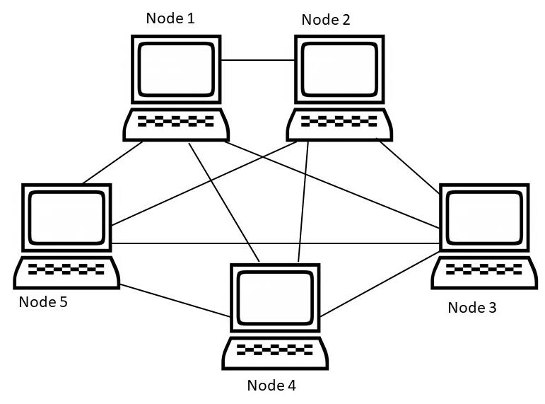
Mesh Topology
All the devices are connected to each other .
There exists a dedicated point-to-point link between all devices.
There are n(n-1) physical channels to link n devices.
Every device not only sends its own data but also relays data from other nodes.
For ‘n’ nodes,
there are n(n-1) physical-links
there are n(n-1)/2 duplex-mode links
Every device must have (n–1) I/O ports to be connected to the other (n-1) devices.

Slide 23
Mesh Topology
Advantages:
Congestion reduced: Each connection can carry its own data load.
Robustness: If one link fails, it does not affect the entire system.
Security: When a data travels on a dedicated-line, only intended-receiver can see the data.
Easy fault identification & fault isolation: Traffic can be re-routed to avoid problematic links.
Disadvantages:
Difficult installation and reconfiguration.
Bulk of wiring occupies more space than available space.
Very expensive: as there are many redundant connections.
Not mostly used in computer networks. It is commonly used in wireless networks.
High redundancy of the network-connections.

Slide 24
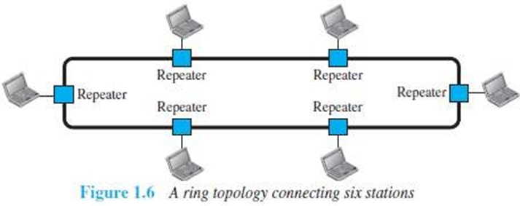
Ring Topology
Each device is connected to the next, forming a ring.
There are only two neighbors for each device.
Data travels around the network in one direction till the destination is reached.
Sending and receiving of data takes place by the help of token.
Each device has a repeater.
A repeater
receives a signal on transmission-medium
regenerates & passes the signal to next device.

Slide 25
Ring Topology
Advantages:
Easy installation and reconfiguration.
To add/delete a device, requires changing only 2 connections.
Fault isolation is simplified.
If one device does not receive a signal within a specified period, it can issue an alarm. The alarm alerts the network-operator to the problem and its location.
Congestion reduced: Because all the traffic flows in only one direction.
Disadvantages:
Unidirectional traffic.
A fault in the ring/device stops all transmission.
The above 2 drawbacks can be overcome by using dual ring.
3. There is a limit on
i)Cable length
ii)Number of nodes that can be connected.
4. Slower: Each data must pass through all the devices between source and destination.

Slide 26
Network Types
Two popular types of networks:
LAN (Local Area Network)
WAN (Wide Area Network)
LAN
LAN is used to connect computers in a single office, building or campus.
LAN is usually privately owned network.
A LAN can be simple or complex.
Simple: LAN may contain 2 PCs and a printer.
Complex: LAN can extend throughout a company.
Each host in a LAN has an address that uniquely defines the host in the LAN.
A packet sent by a host to another host carries both source host’s and destination host’s addresses.
LANs use a smart connecting switch.

Slide 27
Network Types
The switch is able to
recognize the destination address of the packet &
guide the packet to its destination.
The switch
reduces the traffic in the LAN &
allows more than one pair to communicate with each other at the same time.
Advantages:
Resource Sharing
Computer resources like printers and hard disks can be shared by all devices on the network.
Expansion
Nowadays, LANs are connected to WANs to create communication at a wider level.

Slide 28
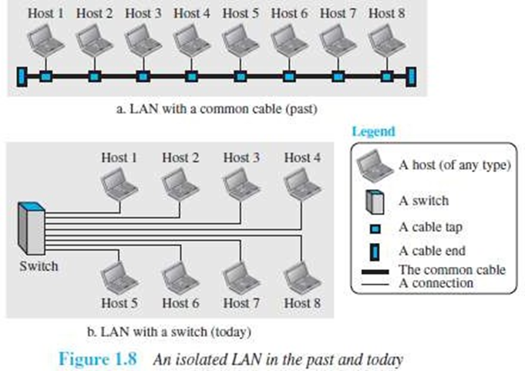
Network Types

Slide 29
Network types
WAN
WAN is used to connect computers anywhere in the world.
WAN can cover larger geographical area. It can cover cities, countries and even continents.
WAN interconnects connecting devices such as switches, routers, or modems.
Normally, WAN is
created & run by communication companies (Ex: BSNL, Airtel)
leased by an organization that uses it.

Slide 30
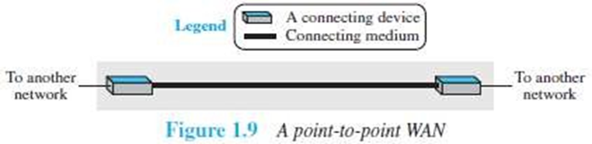
Network types
A WAN can be of 2 types:
1. Point-to-Point WAN
A point-to-point WAN is a network that connects 2 communicating devices through a transmission media

Slide 31
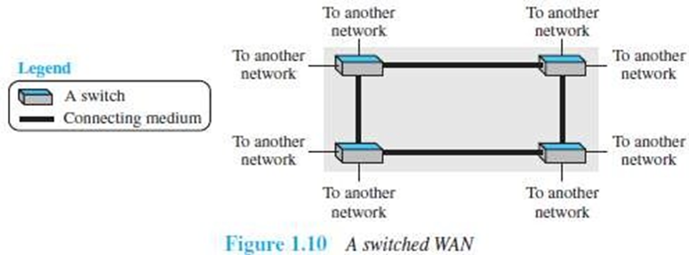
Network types
2. Switched WAN
A switched WAN is a network with more than two ends.
The switched WAN can be the backbones that connect the Internet.
A switched WAN is a combination of several point-to-point WANs that are connected by switches

Slide 32
Internetwork
A network of networks is called an internet. (Internet inter-network).
Assume that an organization has two offices,
First office is on the east coast &
Second office is on the west coast.
Each office has a LAN that allows all employees in the office to communicate with each other.
To allow communication between employees at different offices, the management leases a point-to-point dedicated WAN from a ISP and connects the two LANs.
(ISP Internet service provider such as a telephone company ex: BSNL).

Slide 33
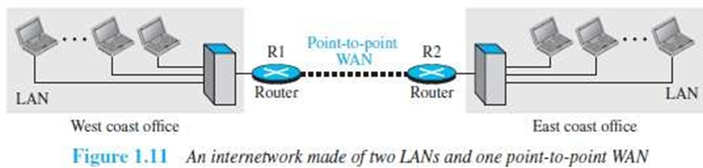
Internetwork
When a host in the west coast office sends a message to another host in the same office, the router blocks the message, but the switch directs the message to the destination.
On the other hand, when a host on the west coast sends a message to a host on the east coast, router R1 routes the packet to router R2, and the packet reaches the destination.

Slide 34
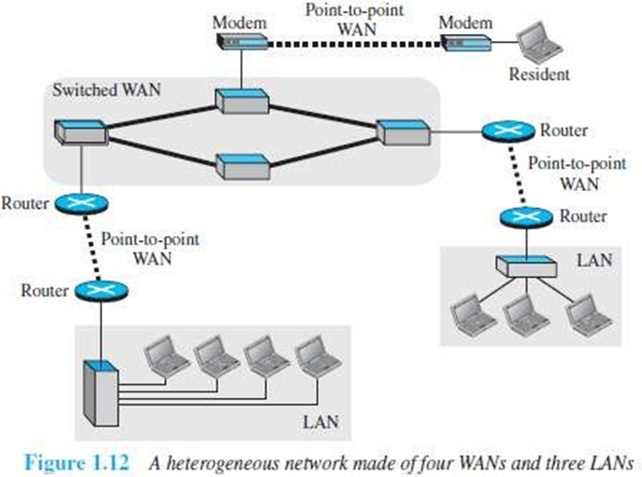
Internetwork

Slide 35
Switching
An internet is a switched network in which a switch connects at least two links together.
A switch needs to forward data from a network to another network when required.
Two types of switched networks are
circuit-switched networks.
packet-switched networks.

Slide 36
Circuit Switched Network
A dedicated connection, called a circuit, is always available between the two end systems.
The switch can only make it active or inactive.
As shown in Figure , the 4 telephones at each side are connected to a switch.
The switch connects a telephone at one side to a telephone at the other side.
A high-capacity line can handle 4 voice communications at the same time.
The capacity of high line can be shared between all pairs of telephones.
The switch is used for only forwarding.

Slide 37
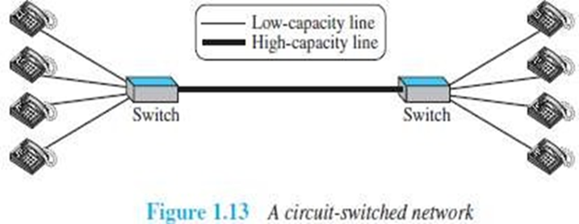
Circuit Switched Network
Advantage:
A circuit-switched network is efficient only when it is working at its full capacity.
Disadvantage:
Most of the time, the network is inefficient because it is working at partial capacity.

Slide 38
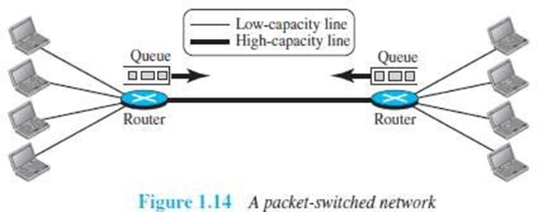
Packet Switched Network
In a computer network, the communication between the 2 ends is done in blocks of data called packets.
The switch is used for both storing and forwarding because a packet is an independent entity that can be stored and sent later.

Slide 39
Packet Switched Network
As shown in Figure , the 4 computers at each side are connected to a router.
A router has a queue that can store and forward the packet.
The high-capacity line has twice the capacity of the low-capacity line.
If only 2 computers (one at each site) need to communicate with each other, there is no waiting for the packets.
However, if packets arrive at one router when high-capacity line is at its full capacity, the packets should be stored and forwarded.
Advantages
A packet-switched network is more efficient than a circuit switched network.
Disadvantage
The packets may encounter some delays.

Slide 40
The Internet Today
A network of networks is called an internet. (Internet → inter-network)
Internet is made up of
Backbones
Provider networks
Customer networks
Backbones
Backbones are large networks owned by communication companies such as BSNL and Airtel.
The backbone networks are connected through switching systems, called peering points.
Provider Networks
Provider networks use the services of the backbones for a fee.
Provider networks are connected to backbones and sometimes to other provider networks.
Customer Networks
Customer networks actually use the services provided by the Internet.
Customer networks pay fees to provider networks for receiving services.

Slide 41
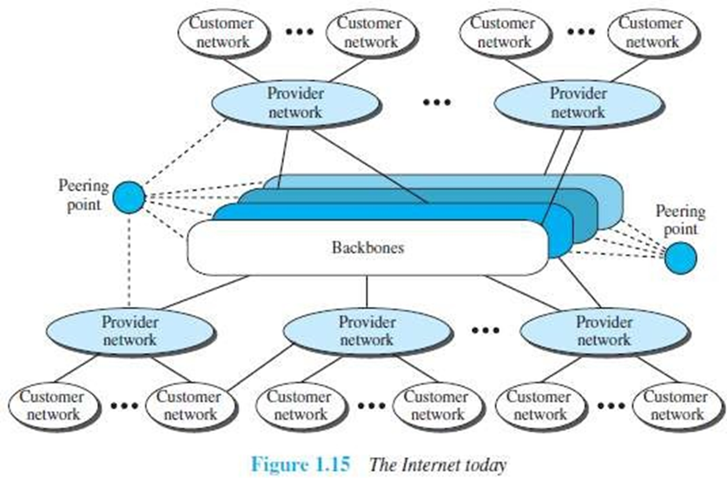
The Internet Today
Backbones and provider networks are also called Internet Service Providers (ISPs).
The backbones are often referred to as international ISPs.
The provider networks are often referred to as national or regional ISPs.

Slide 42
Accessing the Internet
The Internet today is an internetwork that allows any user to become part of it.
However, the user needs to be physically connected to an ISP.
The physical connection is normally done through a point-to-point WAN.
Using Telephone Networks
Most residences have telephone service, which means they are connected to a telephone network.
Most telephone networks have already connected themselves to the Internet.
Thus, residences can connect to the Internet using a point-to-point WAN.
This can be done in two ways:

Slide 43
Accessing the Internet
A)Dial-up service
A modem can be added to the telephone line.
A modem converts data to voice.
The software installed on the computer
→ dials the ISP &
→ imitates making a telephone connection.
Disadvantages:
The dial-up service is very slow.
When line is used for Internet connection, it cannot be used for voice connection.
It is only useful for small residences.
B)DSL Service
DSL service also allows the line to be used simultaneously for voice & data communication.
Some telephone companies have upgraded their telephone lines to provide higher speed Internet services to residences.

Slide 44
Accessing the Internet
2)Using Cable Networks
A residence can be connected to the Internet by using cable service.
Cable service provides a higher speed connection.
The speed varies depending on the number of neighbors that use the same cable.
3)Using Wireless Networks
A residence can use a combination of wireless and wired connections to access the Internet.
A residence can be connected to the Internet through a wireless WAN.
4)Direct Connection to the Internet
A large organization can itself become a local ISP and be connected to the Internet.
The organization
leases a high-speed WAN from a carrier provider and
connects itself to a regional ISP.

Slide 45
STANDARDS AND ADMINISTRATION
Protocols = rules
Standards = agreed-upon rules
Protocols
communication occurs between entities in different systems.
An entity is anything capable of sending or receiving information.
A protocol is a set of rules that govern data communications.
A protocol defines what is communicated, how it is communicated, and when it is communicated.

Slide 46
STANDARDS AND ADMINISTRATION
The key elements of a protocol are syntax, semantics, and timing.
Syntax: Refers to the structure or format of the data, meaning the order in which they are presented.
Semantics: Refers to the meaning of each section of bits. How is a particular pattern to be interpreted, and what action is to be taken based on that interpretation?
Timing: Refers to two characteristics:
when data should be sent
how fast they can be sent.

Slide 47
STANDARDS AND ADMINISTRATION
Standards:
Standards are essential in creating and maintaining an open and competitive market for equipment manufacturers and in guaranteeing national and international interoperability of data and telecommunications technology and processes.
Standards provide guidelines to manufacturers, vendors, government agencies, and other service providers to ensure the kind of interconnectivity necessary in today's marketplace and in international communications
Data communication standards fall into two categories: de facto (meaning "by fact" or "by convention") and de jure (meaning "by law" or "by regulation").

Slide 48
Standards Organizations
While many organizations are dedicated to the establishment of standards are
International Organization for Standardization (ISO).
International Telecommunication Union-Telecommunication Standards Sector (ITU-T).
American National Standards Institute (ANSI).
Institute of Electrical and Electronics Engineers (IEEE).
Electronic Industries Association (EIA).

Slide 49
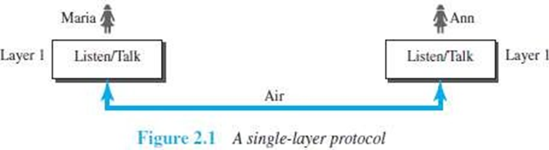
Network Models
PROTOCOL LAYERING
A protocol defines the rules that both the sender and receiver and all intermediate devices need to follow to be able to communicate effectively.
When communication is
Simple: may need only one simple protocol.
Complex: Need to divide the task b/w different layers.
Need a protocol at each layer, or protocol layering.
First Scenario
In the first scenario, communication is so simple that it can occur in only one layer.
Assume Maria and Ann are neighbors with a lot of common ideas.
Communication between Maria and Ann takes place in one layer, face to face, in the same language

Slide 50
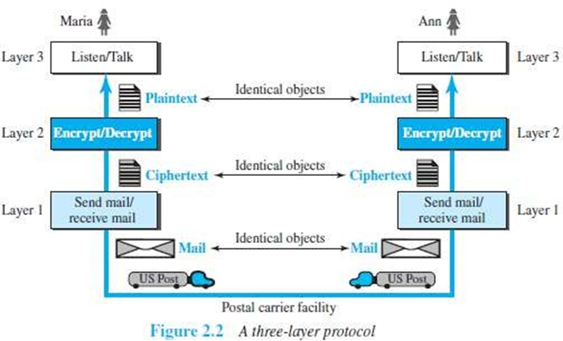
Network Models
Second Scenario
Maria and Ann communicate using regular mail through the post office.
However, they do not want their ideas to be revealed by other people if the letters are intercepted.
They agree on an encryption/decryption technique.
The sender of the letter encrypts it to make it unreadable by an intruder; the receiver of the letter decrypts it to get the original letter.

Slide 51
Protocol Layering
Protocol layering enables us to divide a complex task into several smaller and simpler tasks.
Modularity means independent layers.
A layer (module) can be defined as a black box with inputs and outputs, without concern about how inputs are changed to outputs.
If two machines provide the same outputs when given the same inputs, they can replace each other.
Advantages:
It allows us to separate the services from the implementation.
There are intermediate systems that need only some layers, but not all layers.
Disadvantage:
Having a single layer makes the job easier. There is no need for each layer to provide a service to the upper layer and give service to the lower layer.

Slide 52
Principles of Protocol Layering
First Principle
If we want bidirectional communication, we need to make each layer able to perform 2 opposite tasks, one in each direction.
e.g. : the third layer task is to listen (in one direction) and talk (in the other direction).
Second Principle
The two objects under each layer at both sites should be identical.
e.g. : the object under layer 3 at both sites should be a plaintext letter.

Slide 53
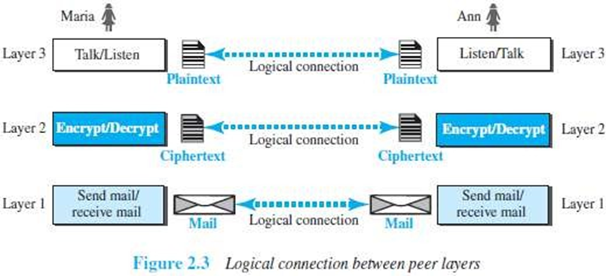
Logical Connections
We have layer-to-layer communication.
There is a logical connection at each layer through which two end systems can send the object created from that layer.

Slide 54
TCP/IP PROTOCOL SUITE
TCP/IP is a protocol-suite used in the Internet today.
Protocol-suite refers a set of protocols organized in different layers.
It is a hierarchical protocol made up of interactive modules, each of which provides a specific functionality.
The term hierarchical means that each upper level protocol is supported by the services provided by one or more lower level protocols.
Let us assume that computer A communicates with computer B.
As the Figure shows, we have five communicating devices:
1) Source host(computer A) 2) Link-layer switch in link 1 3) Router
4) Link-layer switch in link 2 5) Destination host (computer B).
Each device is involved with a set of layers depending on the role of the device in the internet.

Slide 55
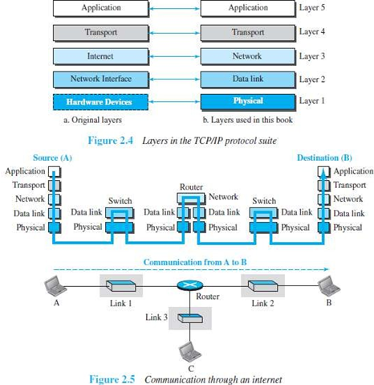
TCP/IP PROTOCOL SUITE

Slide 56
TCP/IP PROTOCOL SUITE
The source host
creates a message in the application layer
sends the message down the layers so that it is physically sent to the destination host.
The destination host
receives the message at the physical layer
then deliver the message through the other layers to the application layer.
The router is involved in only three layers; there is no transport or application layer.
A router is involved in n combinations of link and physical layers.
where n = number of links the router is connected to.
The reason is that each link may use its own data-link or physical protocol.
A link-layer switch is involved only in two layers: i) data-link and ii) physical.

Slide 57
TCP/IP PROTOCOL SUITE
As shown in the figure, the duty of the application, transport, and network layers is end-to-end.
The duty of the data-link and physical layers is hop-to-hop. A hop is a host or router.
The domain of duty of the top three layers is the internet. The domain of duty of the two lower layers is the link.
In top 3 layers, the data unit should not be changed by any router or link-layer switch.
In bottom 2 layers, the data unit is changed only by the routers, not by the link-layer switches.
Identical objects exist between two hops. Because router may fragment the packet at the network layer and send more packets than received.
The link between two hops does not change the object.

Slide 58
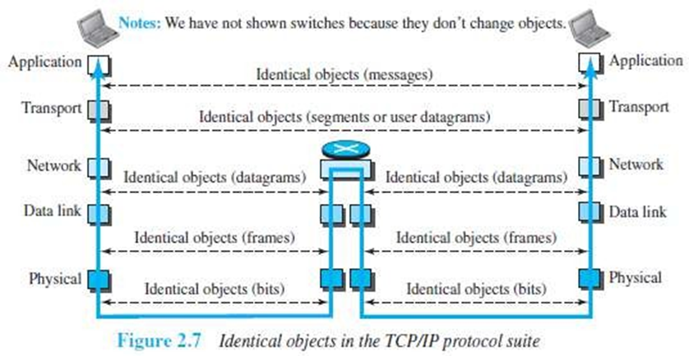
TCP/IP PROTOCOL SUITE

Slide 59
Description of Each Layer
Physical Layer
The physical layer is responsible for movements of individual bits from one node to another node.
Transmission media is another hidden layer under the physical layer.
Two devices are connected by a transmission medium (cable or air).
The transmission medium does not carry bits; it carries electrical or optical signals.
The physical layer
receives bits from the data-link layer &
sends through the transmission media.

Slide 60
Data Link Layer
Data-link-layer (DLL) is responsible for moving frames from one node to another node over a link.
The link can be wired LAN/WAN or wireless LAN/WAN.
The data-link layer
gets the datagram from network layer
encapsulates the datagram in a packet called a frame.
sends the frame to physical layer.
TCP/IP model does not define any specific protocol.
DLL supports all the standard and proprietary protocols.
Each protocol may provide a different service.
Some protocols provide complete error detection and correction; some protocols provide only error correction.

Slide 61
Network Layer
The network layer is responsible for source-to-destination transmission of data.
The network layer is also responsible for routing the packet.
The routers choose the best route for each packet.
Why we need the separate network layer?
The separation of different tasks between different layers.
The routers do not need the application and transport layers.
TCP/IP model defines 5 protocols:
1) IP (Internetworking Protocol) 2) ARP (Address Resolution Protocol)
3) ICMP (Internet Control Message Protocol) 4) IGMP (Internet Group Message Protocol)

Slide 62
Network Layer
1) IP
IP is the main protocol of the network layer.
IP defines the format and the structure of addresses.
IP is also responsible for routing a packet from its source to its destination.
It is a connection-less & unreliable protocol.
Connection-less means there is no connection setup b/w the sender and the receiver.
Unreliable protocol means
IP does not make any guarantee about delivery of the data.
Packets may get dropped during transmission.
It provides a best-effort delivery service.
Best effort means IP does its best to get the packet to its destination, but with no guarantees.
IP does not provide following services
flow control
error control
congestion control services.
If an application requires above services, the application should rely only on the transport- layer protocol.

Slide 63
Network Layer
2)ARP
ARP is used to find the physical-address of the node when its Internet-address is known.
Physical address is the 48-bit address that is imprinted on the NIC or LAN card.
Internet address (IP address) is used to uniquely & universally identify a device in the internet.
3)ICMP
ICMP is used to inform the sender about datagram-problems that occur during transit.
4)IGMP
IGMP is used to send the same message to a group of recipients.

Slide 64
Transport Layer
TL protocols are responsible for delivery of a message from a process to another process.
The transport layer
gets the message from the application layer
encapsulates the message in a packet called a segment and sends the segment to network layer.
TCP/IP model defines 3 protocols:
TCP (Transmission Control Protocol)
UDP (User Datagram Protocol)
SCTP (Stream Control Transmission Protocol)

Slide 65
Transport Layer
1) TCP
TCP is a reliable connection-oriented protocol.
A connection is established b/w the sender and receiver before the data can be transmitted.
TCP provides
flow control
error control and
congestion control
2) UDP
UDP is the simplest of the 3 transport protocols.
It is an unreliable, connectionless protocol.
It does not provide flow, error, or congestion control.
Each datagram is transported separately & independently.
It is suitable for application program that
Needs to send short messages
cannot afford the retransmission.
3) SCTP
SCTP provides support for newer applications such as voice over the Internet.
It combines the best features of UDP and TCP.

Slide 66
Application Layer
The two application layers exchange messages between each other.
Communication at the application layer is between two processes (two programs running at this layer).
To communicate, a process sends a request to the other process and receives a response.
Process-to-process communication is the duty of the application layer.
TCP/IP model defines following protocols:
SMTP is used to transport email between a source and destination.
TELNET is used for accessing a site remotely.
FTP is used for transferring files from one host to another.
DNS is used to find the IP address of a computer.
SNMP is used to manage the Internet at global and local levels.
HTTP is used for accessing the World Wide Web (WWW).

Slide 67
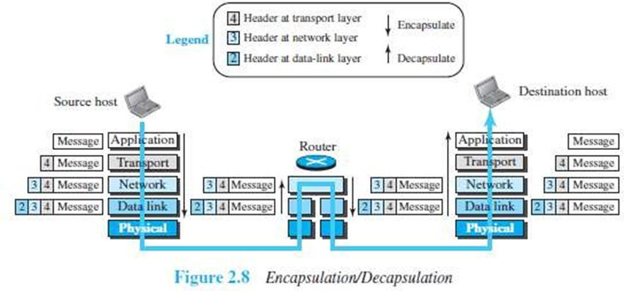
Encapsulation and Decapsulation

Slide 68
Encapsulation at the Source Host
At the source, we have only encapsulation
At the application layer, the data to be exchanged is referred to as a message.
A message normally does not contain any header or trailer.
The message is passed to the transport layer.
The transport layer takes the message as the payload.
TL adds its own header to the payload.
The header contains
identifiers of the source and destination application programs
information needed for flow, error control, or congestion control.
The transport-layer packet is called the segment (in TCP) and the user datagram (in UDP).
The segment is passed to the network layer.

Slide 69
Encapsulation at the Source Host
3.The network layer takes the transport-layer packet as payload.
NL adds its own header to the payload.
The header contains
addresses of the source and destination hosts
some information used for error checking of the header & fragmentation information.
The network-layer packet is called a datagram.
The datagram is passed to the data-link layer.
4. The data-link layer takes the network-layer packet as payload.
DLL adds its own header to the payload.
The header contains the physical addresses of the host or the next hop (the router).
The link-layer packet is called a frame.
The frame is passed to the physical layer for transmission

Slide 70
Decapsulation and Encapsulation at the Router
At the router, we have both encapsulation & decapsulation and because the router is connected to two or more links.
1)Data-link layer
receives frame from physical layer
decapsulates the datagram from the frame
passes the datagram to the network layer.
2)The network layer
inspects the source and destination addresses in the datagram header and
consults forwarding table to find next hop to which the datagram is to be delivered.
The datagram is then passed to the data-link layer of the next link.
3)The data-link layer of the next link
encapsulates the datagram in a frame and
passes the frame to the physical layer for transmission.

Slide 71
Decapsulation at the Destination Host
At the destination host, each layer
decapsulates the packet received from lower layer
removes the payload and
delivers the payload to the next-higher layer

Slide 72
THE OSI MODEL
OSI model was developed by ISO.
ISO is the organization.
OSI is the model.
Purpose: OSI was developed to allow systems with different platforms to communicate with each other.
Platform means hardware, software or operating system.
OSI is a network-model that defines the protocols for network communications.

Slide 73
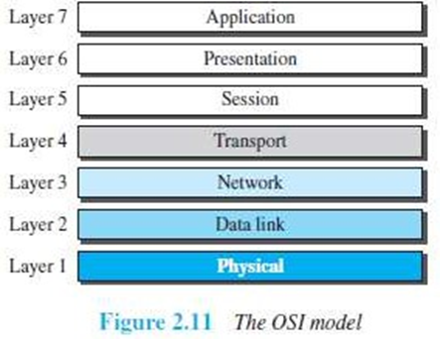
THE SEVEN LAYER OSI MODEL
OSI has 7 layers as follows :
Application Layer
Presentation Layer
Session Layer
Transport Layer
Network Layer
Data Link Layer
Physical Layer
Each layer has specific duties to perform and has to co-operate with the layers above & below it.

Slide 74
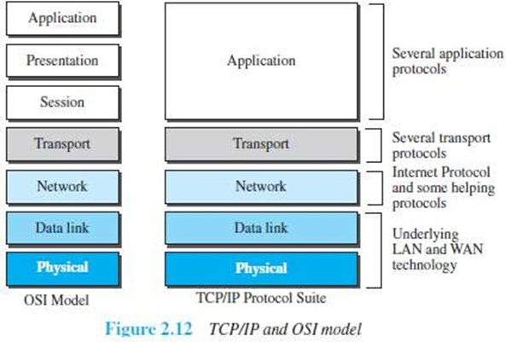
OSI vs. TCP/IP
The four bottommost layers in the OSI model & the TCP/IP model are same . However, the Application-layer of TCP/IP model corresponds to the Session, Presentation & Application Layer of OSI model.
Two reasons for this are:
TCP/IP has more than one transport-layer protocol.
Many applications can be developed at Application layer
The OSI model specifies which functions belong to each of its layers.
In TCP/IP model, the layers contain relatively independent protocols that can be mixed and matched depending on the needs of the system.

